Slide 1
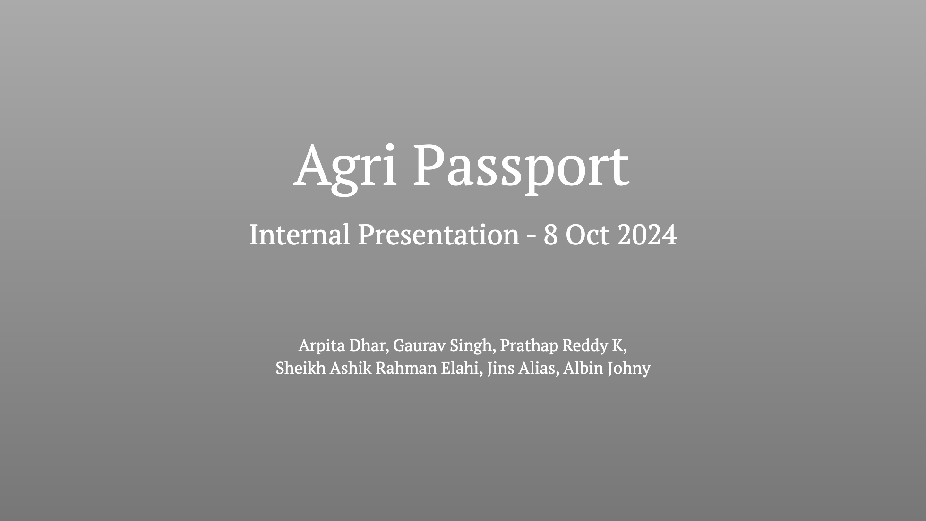

Slide 2
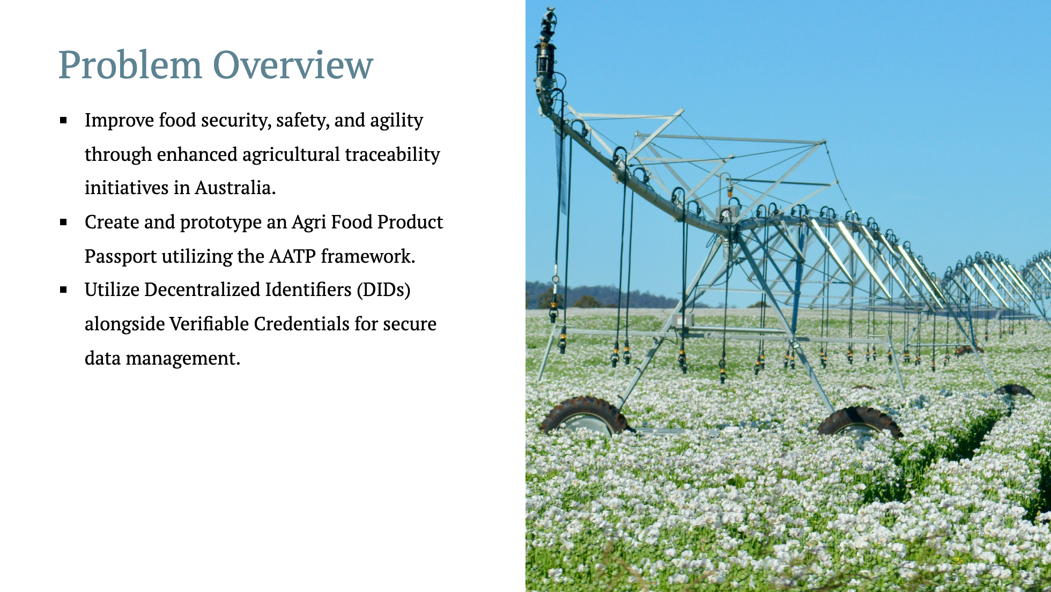
Notes:
The primary challenge we're tackling today is the issue of food security and safety within the agricultural sector in Australia. The idea is to build a system that ensures the food that arrives at our tables is safe, efficiently managed, and traceable throughout the supply chain. <br/><br/> We're aiming to prototype an Agri Food Product Passport, leveraging the AATP framework—essentially creating a digital identity for agricultural products. <br/><br/> By using Decentralized Identifiers (DIDs) and Verifiable Credentials, we're ensuring the data remains secure and verifiable, which ultimately contributes to greater trust in the system from producers, distributors, regulatory bodies, and consumers alike. <br/><br/>Think of this passport as a comprehensive digital record for food items—one that captures every key event from production to distribution, providing insights that enhance both food safety and the efficiency of agricultural processes.

Slide 3
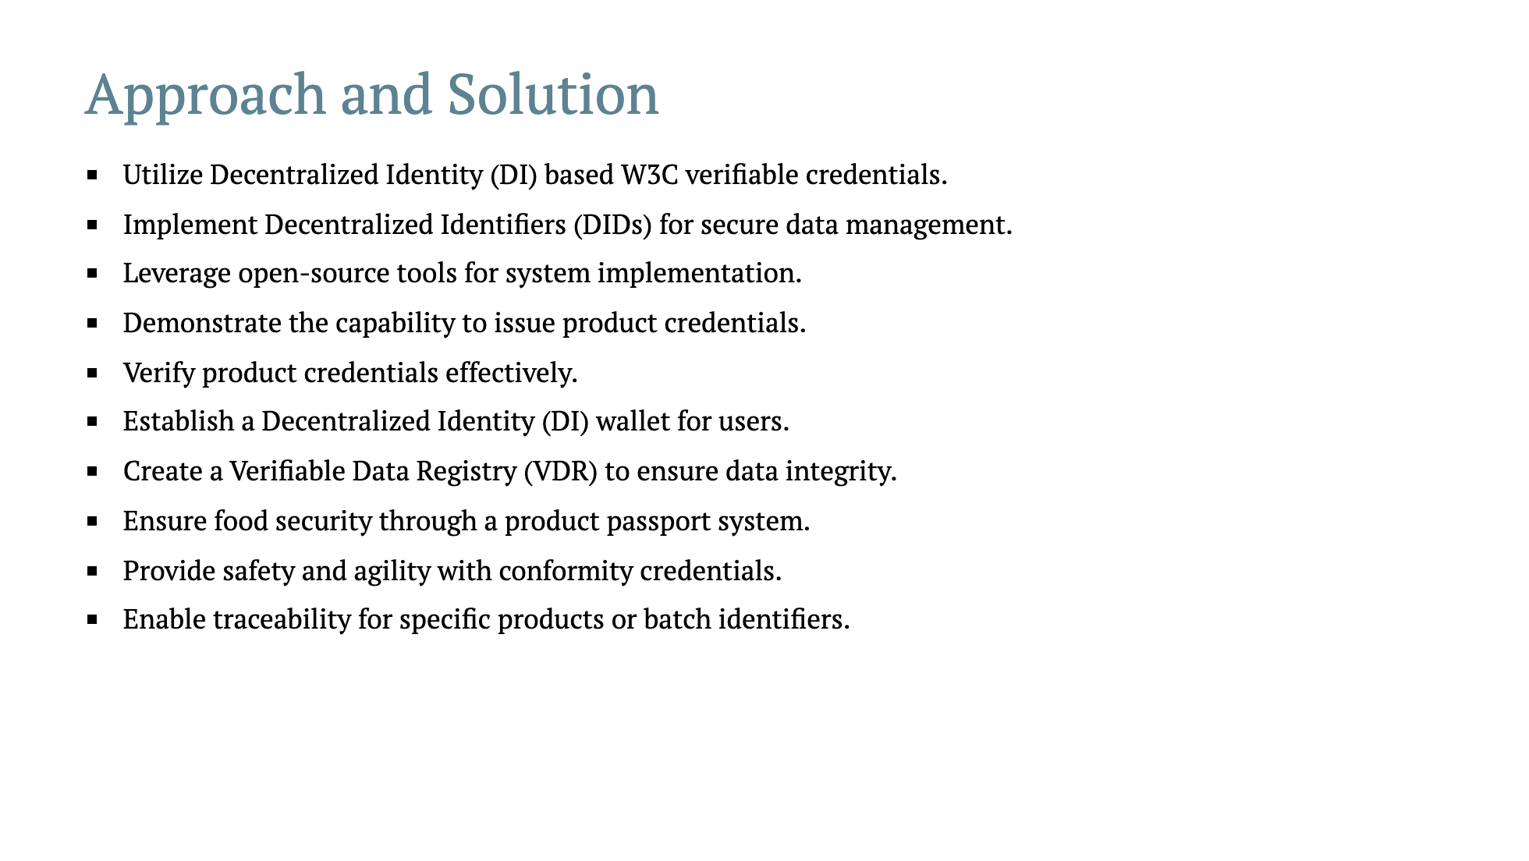
Notes:
Our approach revolves around adopting Decentralized Identity standards that are based on W3C verifiable credentials. This means that each agricultural product will have verifiable credentials associated with it, similar to digital IDs we use for humans. <br/><br/>We use Decentralized Identifiers (DIDs) to securely manage these data interactions, ensuring that every transaction or product update is trustworthy and tamper-proof. <br/><br/>We’re also making use of open-source tools to keep the system transparent and collaborative, allowing contributions from a broader developer community. <br/><br/>This is important for scalability and maintaining security standards. <br/><br/>We will demonstrate how product credentials can be issued and verified, ensuring each product can be traced back through its life cycle. <br/><br/>Additionally, the establishment of a DI wallet allows users to access product credentials easily. The Verifiable Data Registry (VDR) ensures data integrity by recording all key events in the product's journey.<br/><br/>Essentially, with these measures, we not only enhance food security but also provide a robust, secure mechanism for data management throughout the agricultural supply chain.

Slide 4
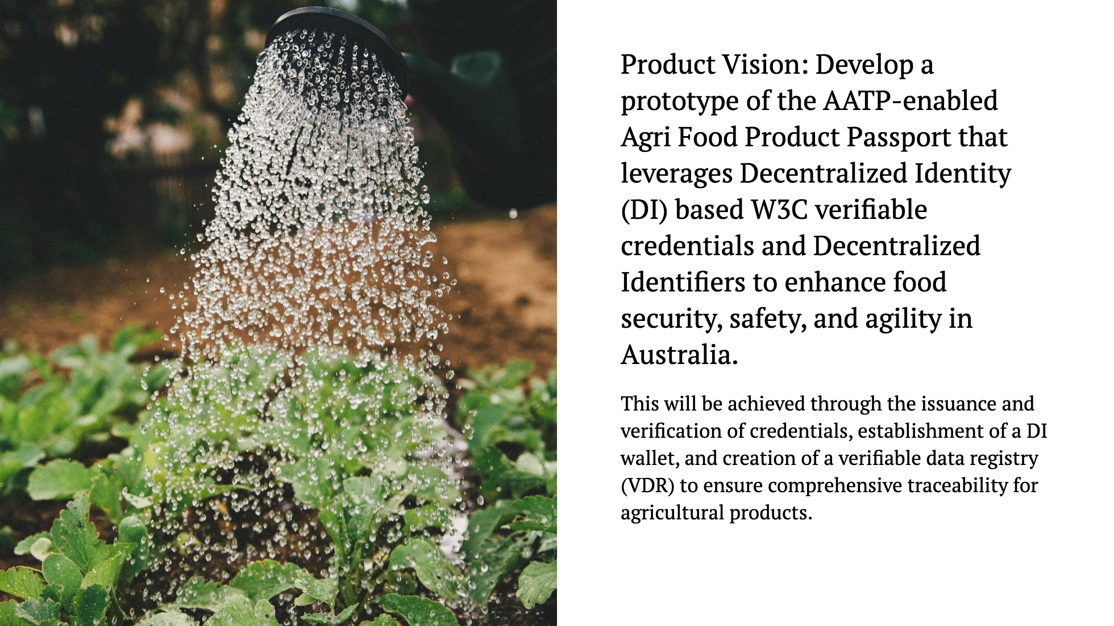
Notes:
The product vision focuses on developing a prototype for the AATP-enabled Agri Food Product Passport, leveraging cutting-edge technologies like Decentralized Identity and W3C verifiable credentials. <br/><br/> This vision is about giving each food product its own unique digital identity—a secure and transparent way to track its entire journey from production to the consumer’s table. <br/><br/> This includes the issuance of verifiable credentials at each critical stage, ensuring authenticity. We’re also building a DI wallet where all these credentials can be stored and accessed securely by users. <br/><br/> Imagine it as a wallet full of digital certificates for each step of the agricultural product’s lifecycle. Finally, a verifiable data registry (VDR) will be created to store this information in a secure and immutable manner. <br/><br/> This comprehensive approach guarantees that all relevant information remains tamper-proof and accessible, ultimately enhancing food security, product safety, and operational agility in the agricultural supply chain.

Slide 5
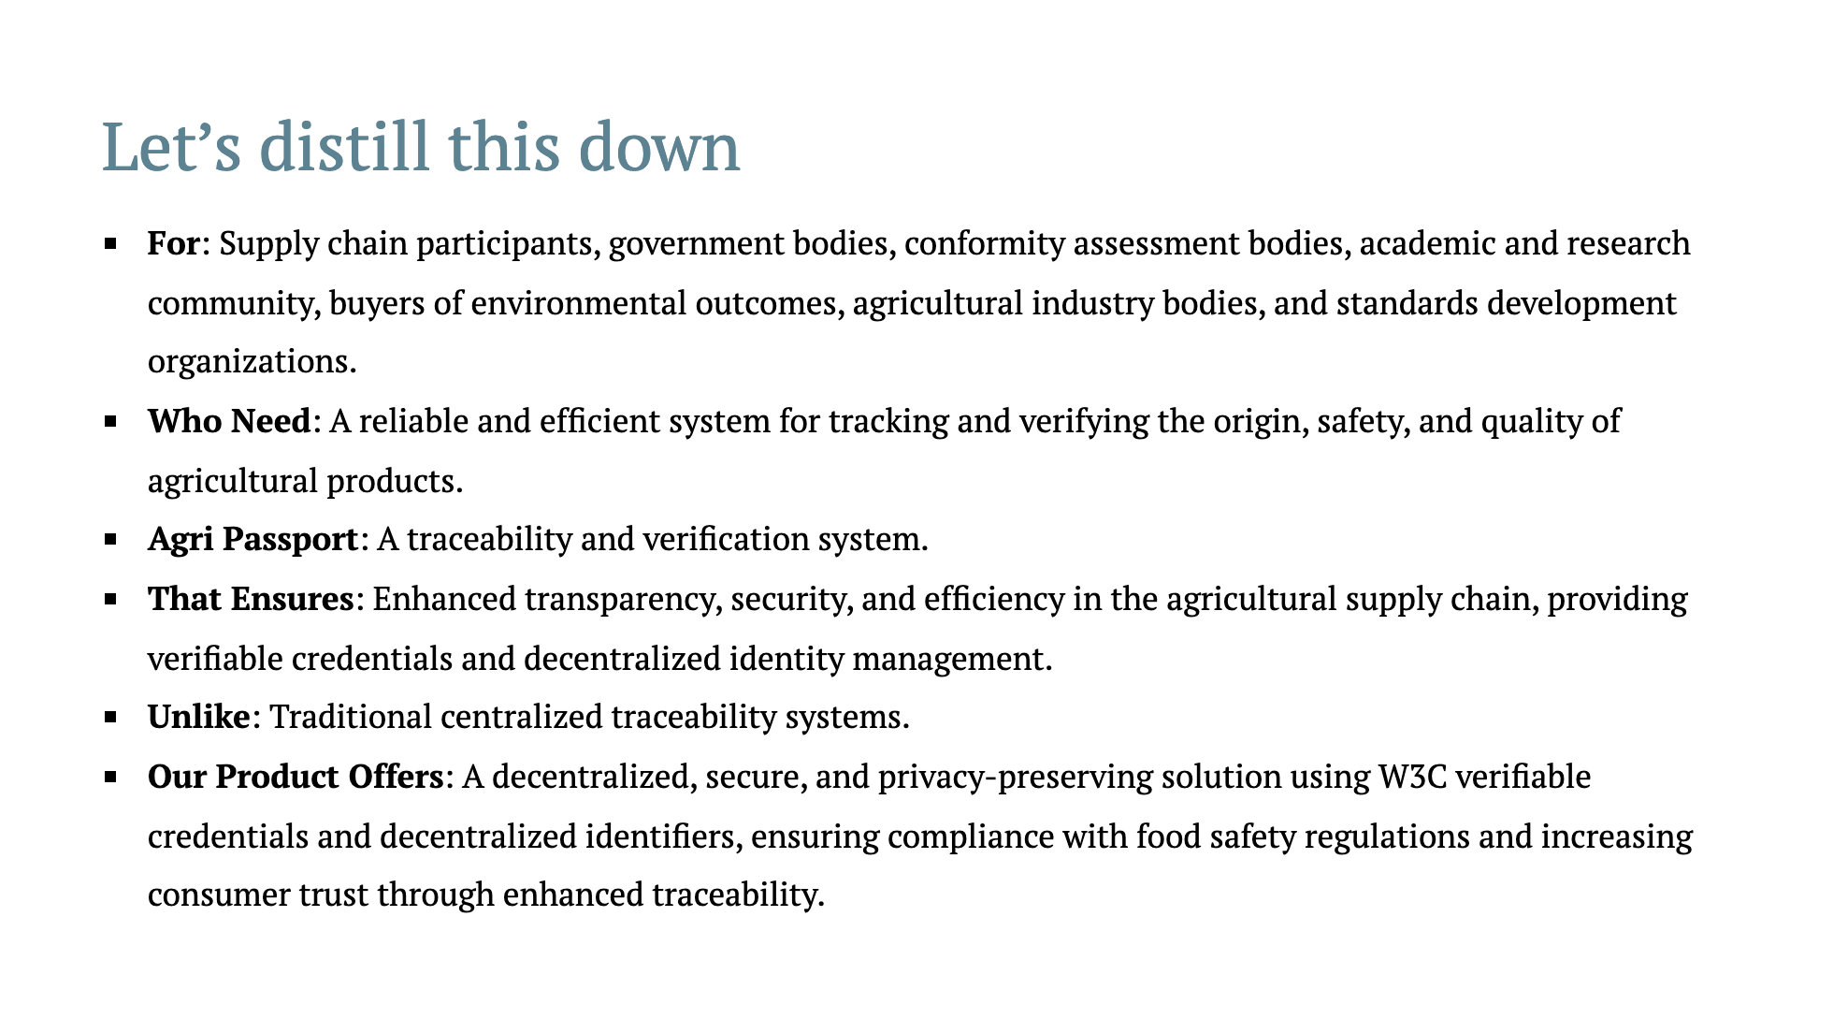
Notes:
Here, we're summarizing what our solution is, who it's for, and why it matters.<br/><br/> This product is designed for stakeholders like supply chain participants, government bodies, researchers, buyers of environmental outcomes, and standards bodies—all of whom need a more effective and trustworthy way to verify the origin, safety, and quality of agricultural products.<br/><br/> The Agri Passport acts as a digital system for tracking and verifying product information.<br/><br/> It goes beyond traditional systems, which are often centralized and prone to data breaches or inaccuracies.<br/><br/> Unlike these conventional systems, our product offers a decentralized solution using W3C verifiable credentials and decentralized identifiers.<br/><br/> This ensures greater transparency, increased privacy, and enhanced security—ultimately helping stakeholders comply with regulations and boosting consumer trust by making product traceability seamless and reliable.<br/><br/>

Slide 6
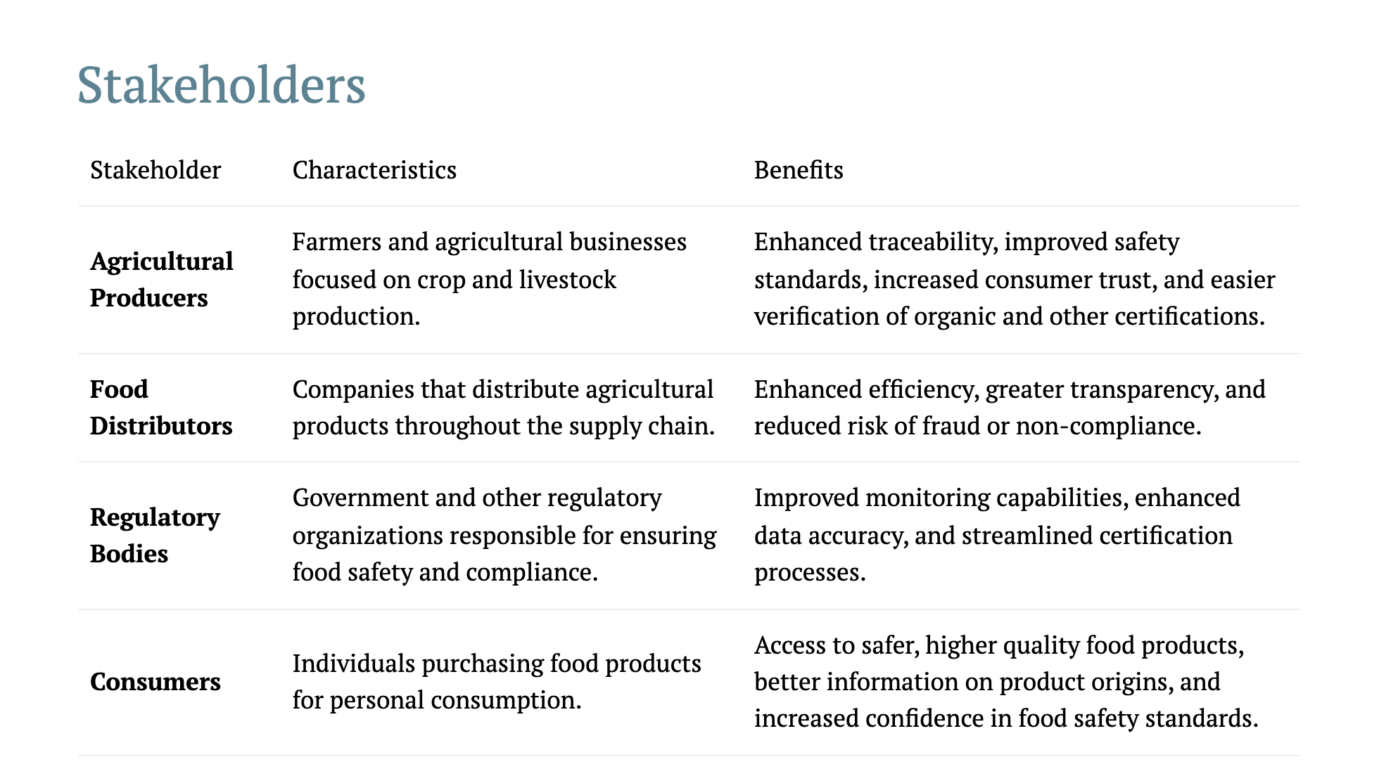
Notes:
We’re targeting multiple stakeholders here, each of whom benefits in specific ways.<br/><br/> For **agricultural producers**, this system provides enhanced traceability, making it easier to verify organic or quality standards certifications.<br/><br/> It boosts consumer trust by ensuring safety and transparency.<br/><br/> **Food distributors** gain from increased efficiency and transparency throughout the supply chain.<br/><br/> Fraud and non-compliance become easier to detect and prevent because every product’s origin and journey are tracked securely.<br/><br/> **Regulatory bodies** can leverage this technology for better monitoring and data accuracy.<br/><br/> They get a streamlined certification process, reducing administrative burdens.<br/><br/> Lastly, **consumers** benefit significantly by having access to information about the food they consume.<br/><br/> They can see where their food comes from, how it’s produced, and be confident that it meets safety standards—ultimately leading to a better, safer, and more informed purchase decision.<br/><br/>

Slide 7
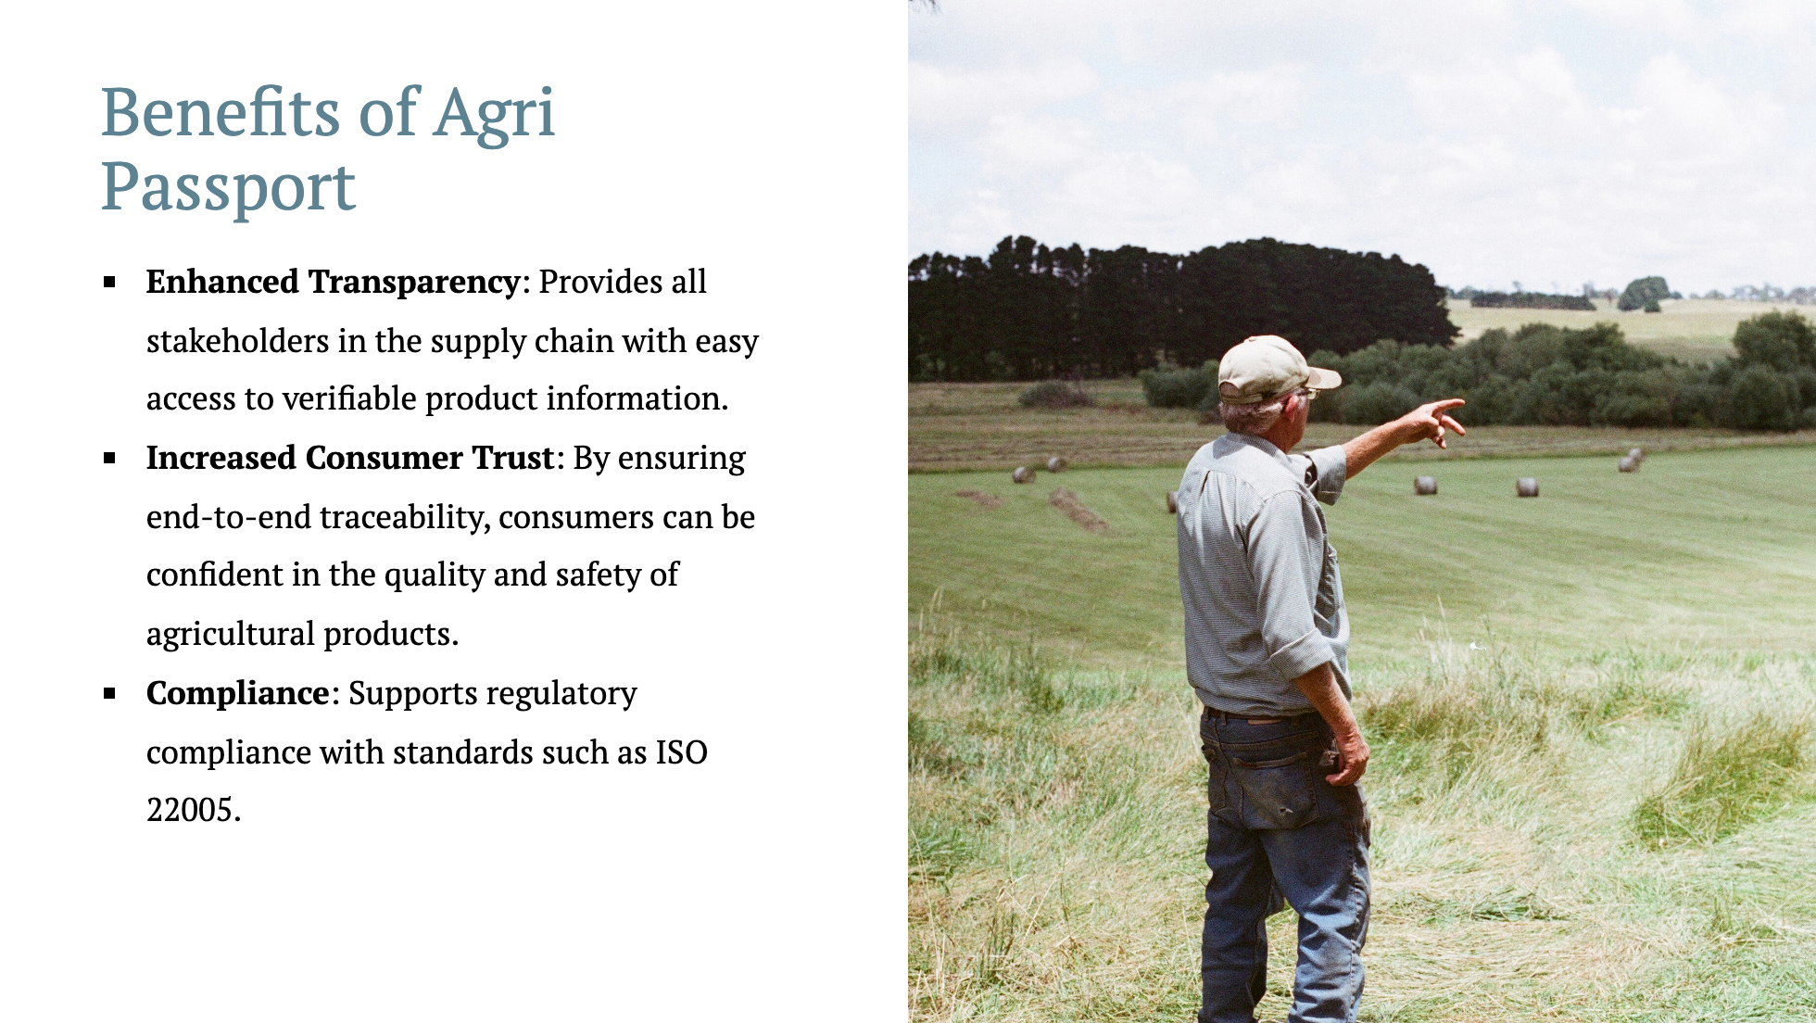
Notes:
The **Agri Passport** offers a range of benefits.<br/><br/> First, it significantly enhances **transparency** across the entire supply chain.<br/><br/> From farmers to retailers, everyone involved can access verifiable information about each product, which means better decision-making and fewer opportunities for miscommunication or misinformation.<br/><br/> For **consumers**, the passport ensures **increased trust** in the quality and safety of their food.<br/><br/> With full traceability, they know where their food is coming from, and they can make informed choices with confidence.<br/><br/> Finally, our system supports **compliance** with important standards like **ISO 22005**.<br/><br/> This means that our product isn’t just about transparency but also about meeting the regulatory requirements that ensure food safety, making the process more straightforward for everyone involved.<br/><br/>

Slide 8
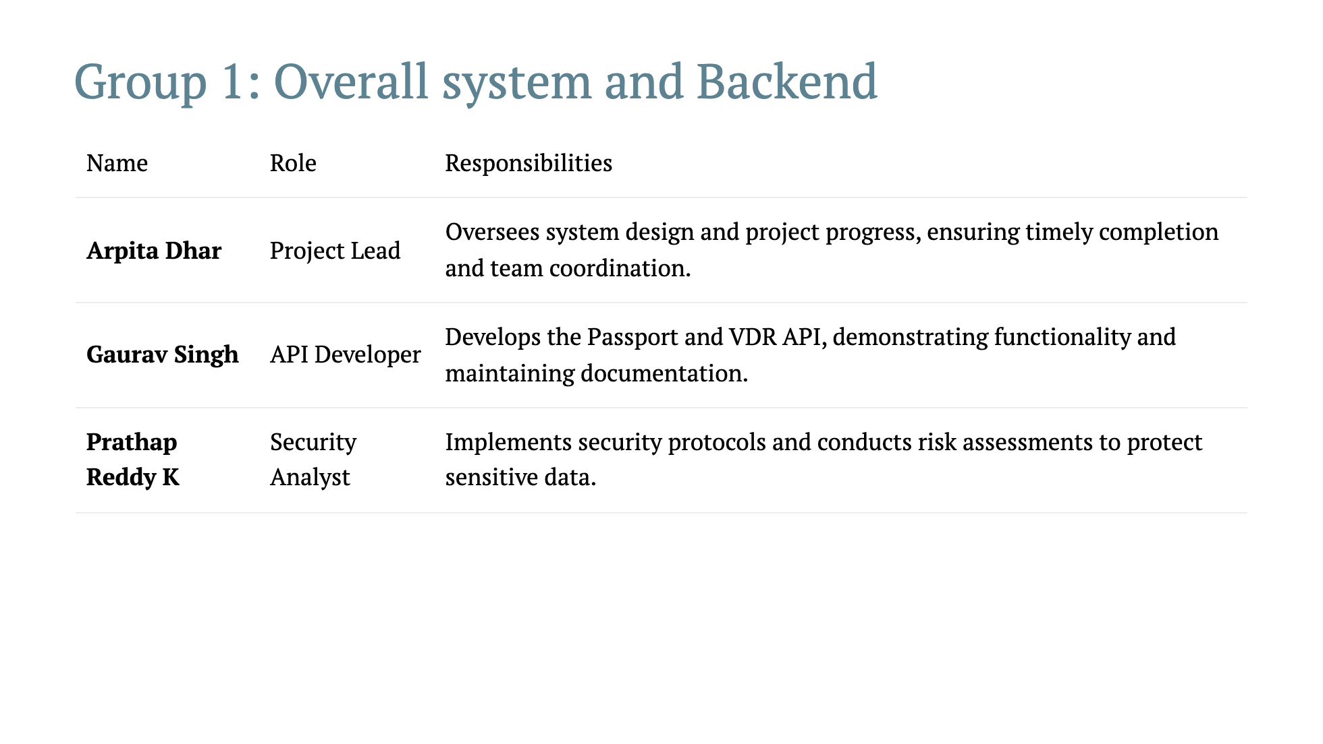

Slide 9
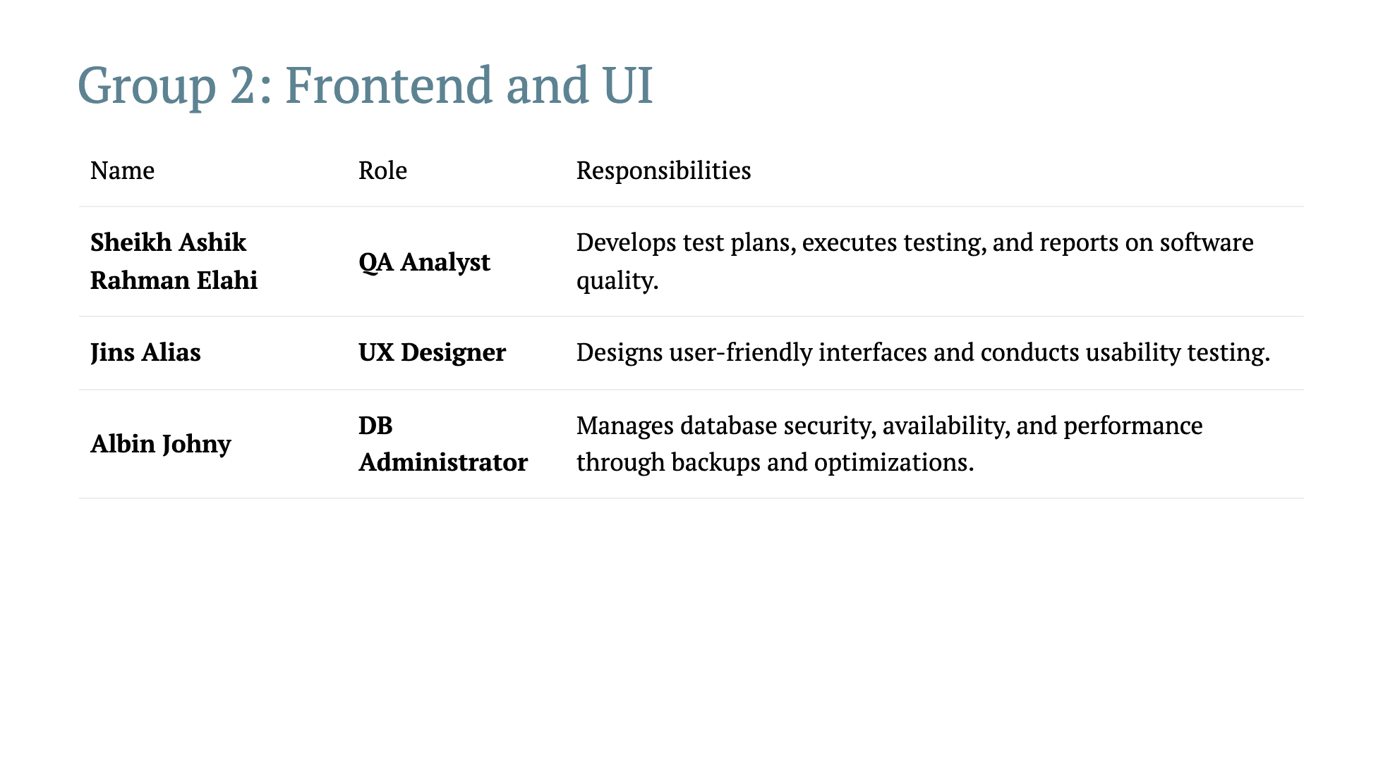

Slide 10
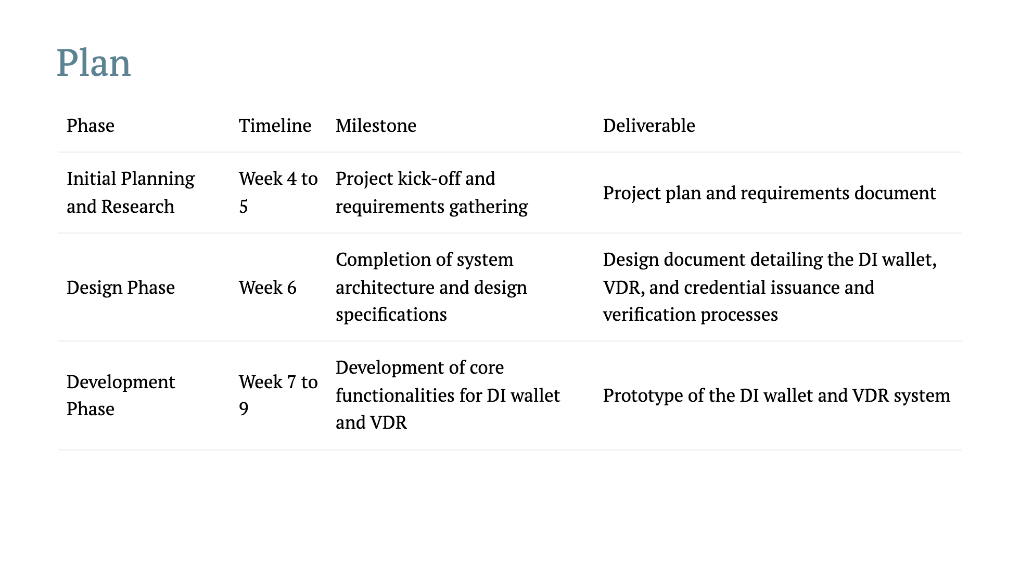

Slide 11
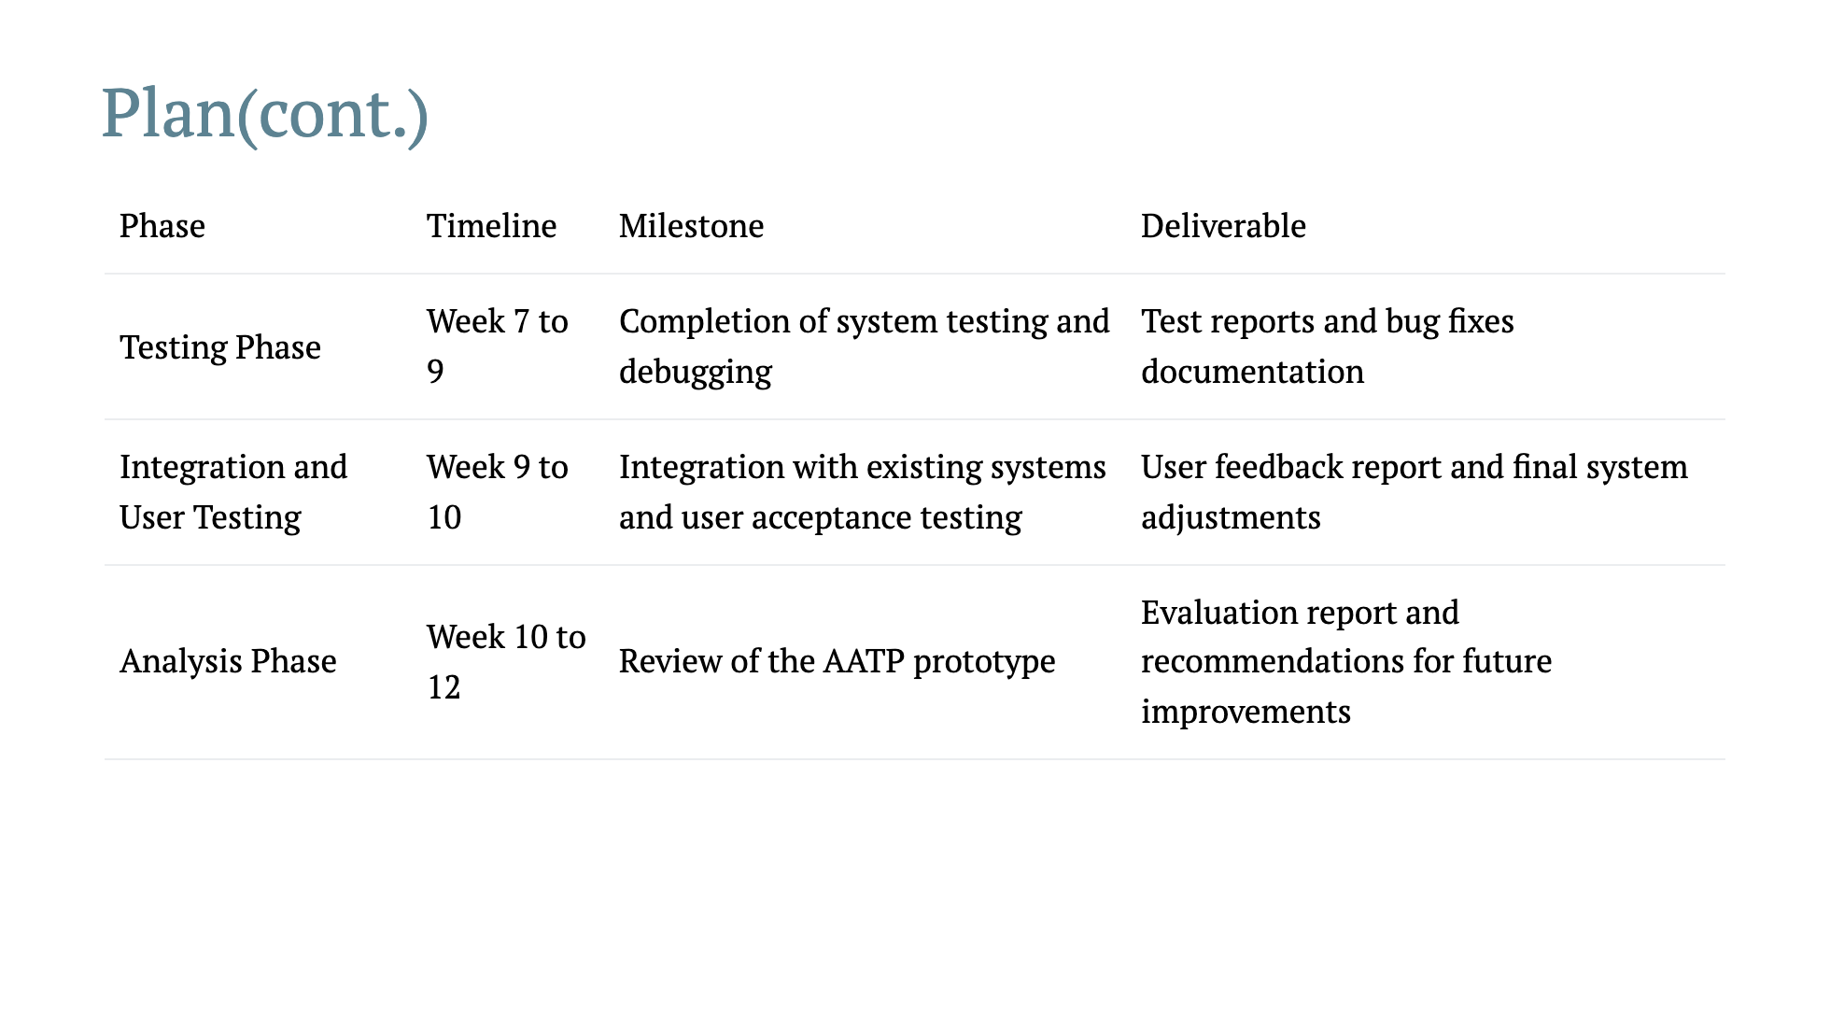

Slide 12
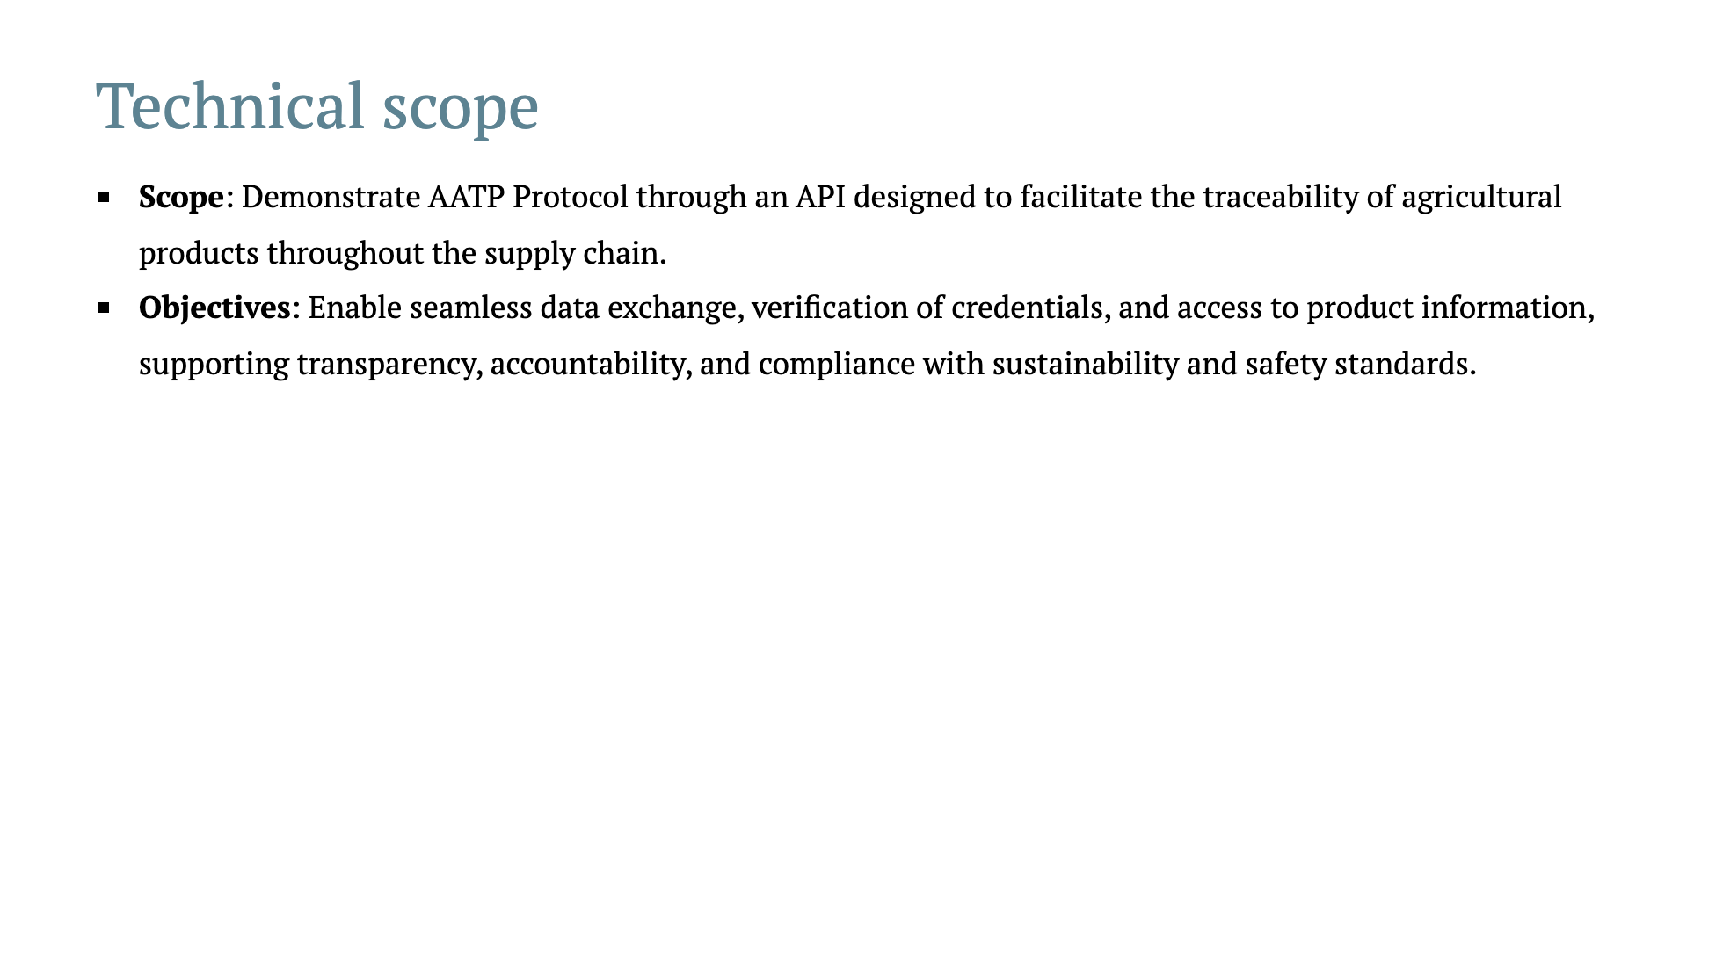
Notes:
The technical scope of our project is to demonstrate how the **AATP Protocol** can enhance agricultural traceability. We are doing this by developing an **API** specifically designed to track agricultural products from the point of production to the end consumer. Our key objectives revolve around enabling seamless **data exchange** across different systems in the supply chain. We want to make sure that **verification of credentials** is straightforward, allowing stakeholders to confirm the origin, safety, and sustainability of agricultural products. Additionally, we focus on ensuring that product information is easily accessible, which is essential for maintaining **transparency** and **accountability**. These elements are critical for compliance with sustainability and food safety standards. Ultimately, we are creating an open and secure environment for the data flow, one that stakeholders can trust.

Slide 13
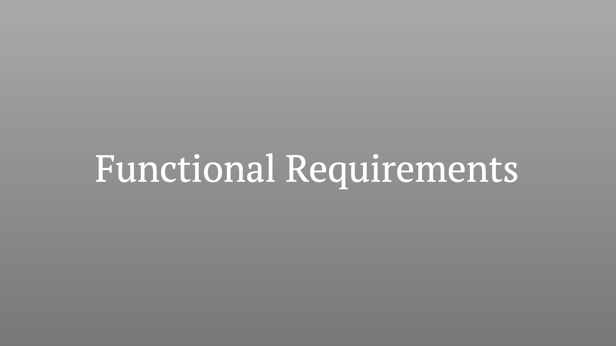
Notes:
In this section, we’ll be discussing the **functional requirements** for our AATP system. These requirements describe the essential capabilities the system must have to fulfill its intended purpose, including data exchange, traceability, and the management of unique product identifiers. The focus is on the actions and interactions that enable the complete functionality of the agricultural traceability system.

Slide 14
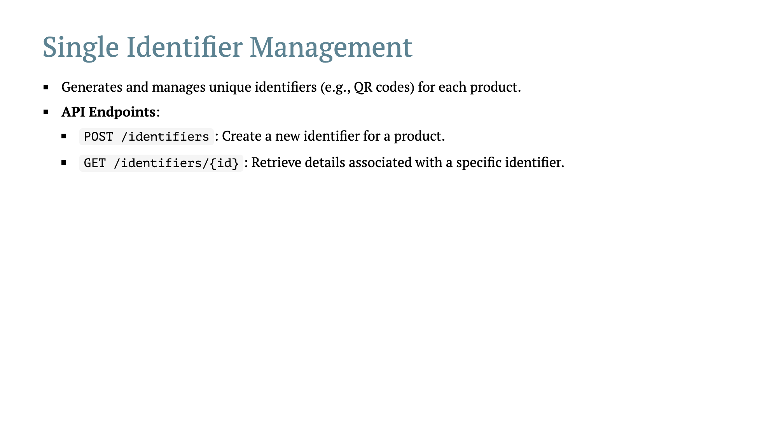
Notes:
An important component of our solution is **Single Identifier Management**. Each agricultural product will have its own **unique identifier**, such as a QR code. This helps in maintaining traceability throughout the entire supply chain. The unique identifiers are generated and managed through dedicated API endpoints. With the `POST /identifiers` endpoint, we can create a new identifier for a product. This essentially assigns a distinct digital "ID card" to each item in the supply chain. Meanwhile, the `GET /identifiers/{id}` endpoint allows us to **retrieve detailed information** linked to that specific identifier. For instance, this could include data such as the product’s origin, processing events, or safety credentials. This kind of detailed tracking is crucial for maintaining integrity and transparency.

Slide 15
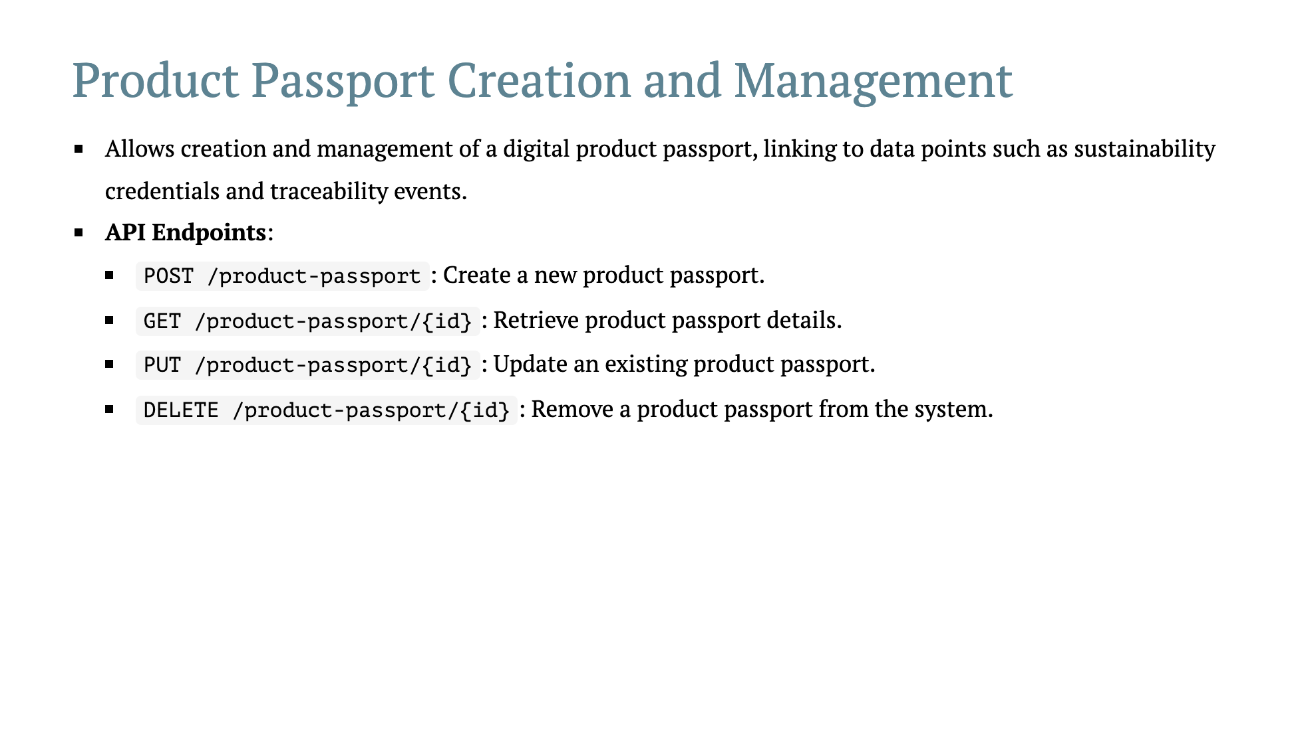
Notes:
The **Product Passport Creation and Management** module is another core feature of our system. The idea here is to provide each product with a digital passport—a comprehensive document that contains all relevant data points, such as **sustainability credentials** and key traceability events. We have specific API endpoints for interacting with product passports: - The `POST /product-passport` endpoint allows the **creation** of a new digital product passport. - `GET /product-passport/{id}` lets stakeholders **retrieve detailed information** about a product passport—this could be anything from its initial production to specific sustainability credentials. - `PUT /product-passport/{id}` allows users to **update** information if the product undergoes changes or certifications. - Lastly, `DELETE /product-passport/{id}` is used when a product passport needs to be **removed** from the system, for instance, if a product is no longer part of the supply chain. By enabling seamless product passport creation and management, we ensure that there is always reliable, up-to-date information available about every product.

Slide 16
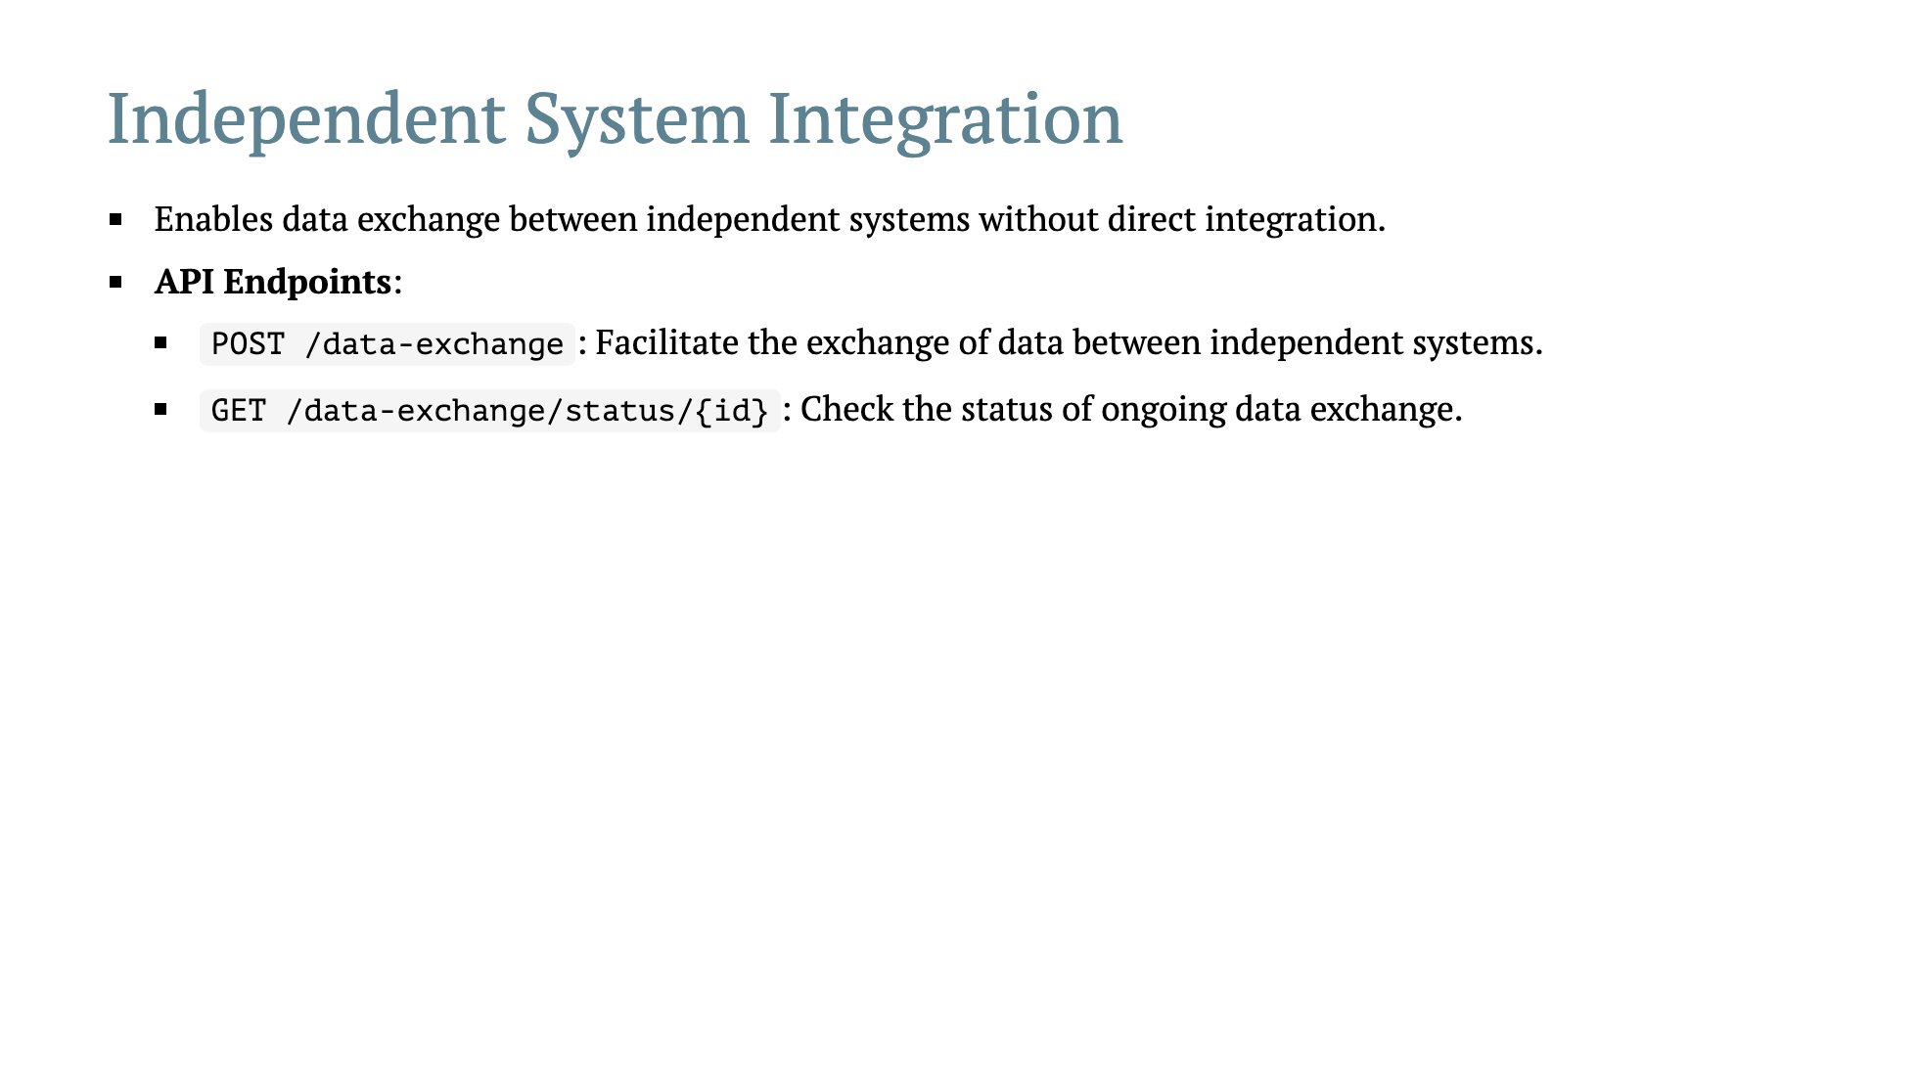
Notes:
One of the challenges in the agricultural sector is the existence of multiple, independent systems that must interact without having direct integration. This slide addresses our solution for **Independent System Integration**. Using our `POST /data-exchange` API endpoint, we facilitate **data exchange** between these systems in a secure and seamless way. Think of it as a bridge—allowing data to flow freely without requiring each system to be tightly coupled with another. This is critical in preserving the integrity of data and allowing flexibility across the supply chain. We also provide a `GET /data-exchange/status/{id}` endpoint to **check the status** of ongoing data exchanges. This ensures that stakeholders are always informed about the progress of data transfers, giving them confidence in the reliability and responsiveness of the system.

Slide 17
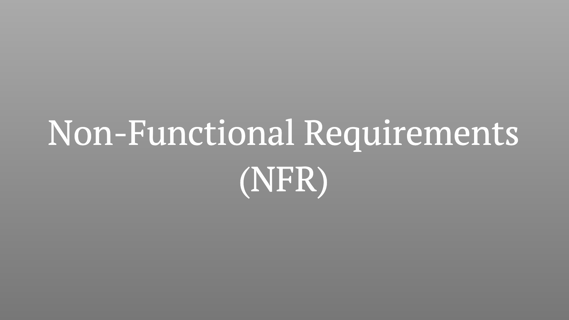
Notes:
The **Non-Functional Requirements** (NFR) are just as critical as the functional ones. These are the requirements that describe how the system should operate rather than what it should do. These requirements ensure the system is **secure**, **performant**, **usable**, **maintainable**, and **compliant** with regulations. They help guide the quality of the overall solution, ensuring that it can effectively meet the needs of all stakeholders in real-world usage.

Slide 18
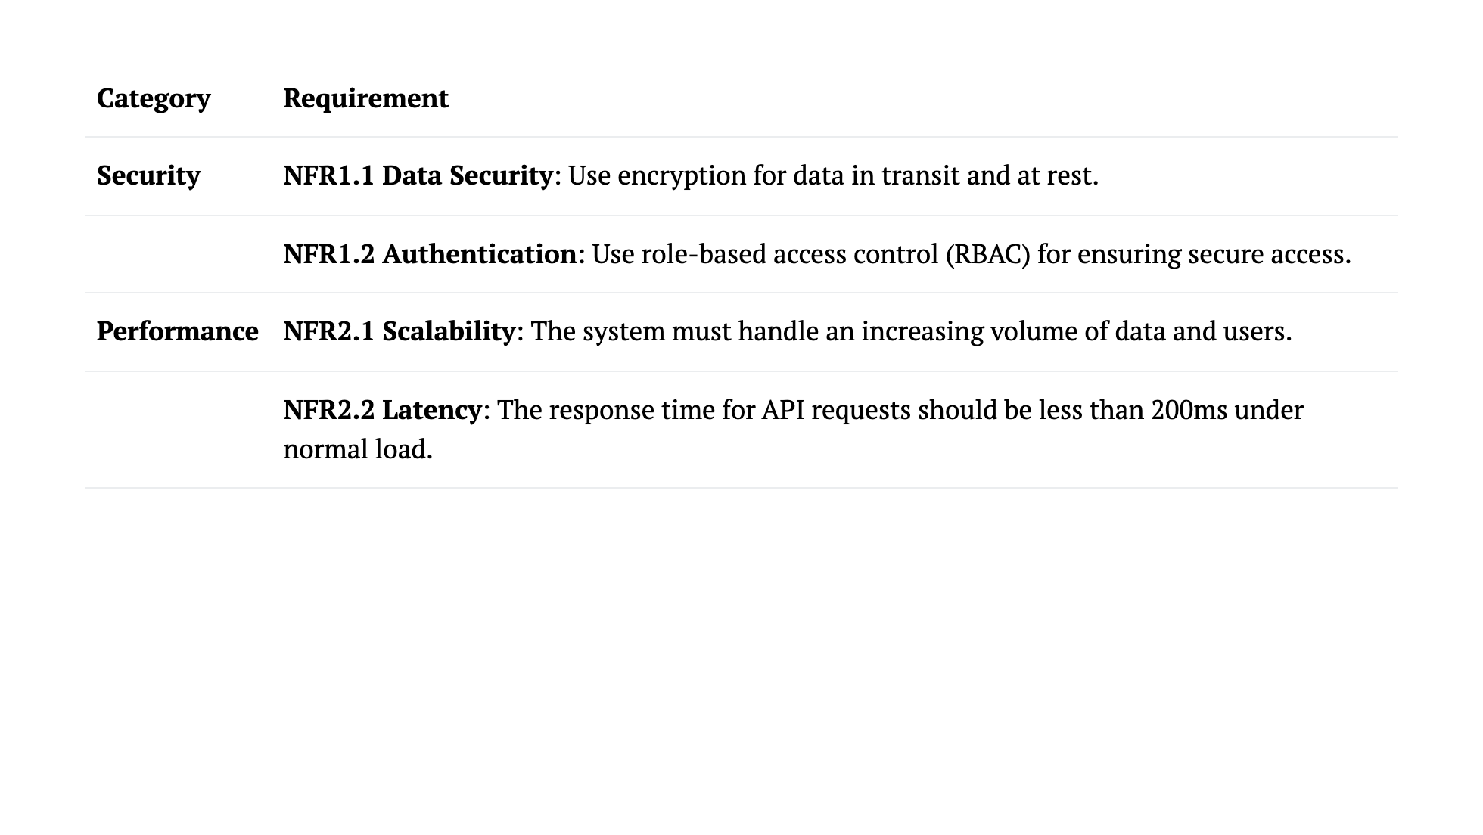
Notes:
Here we address the **security** and **performance** aspects of our system. For **security**, we ensure **data security** by employing **encryption** for both data at rest and data in transit. This guarantees the confidentiality and integrity of data, making sure that unauthorized users cannot intercept or manipulate it. We also use **role-based access control (RBAC)** to ensure that only authorized personnel can access sensitive information or perform critical operations. On the **performance** side, we need the system to be **scalable**—capable of handling an increasing number of users and a growing volume of data without a decrease in performance. Additionally, the system's response times must remain quick and efficient, with a **latency** of less than **200ms** for typical API requests.

Slide 19
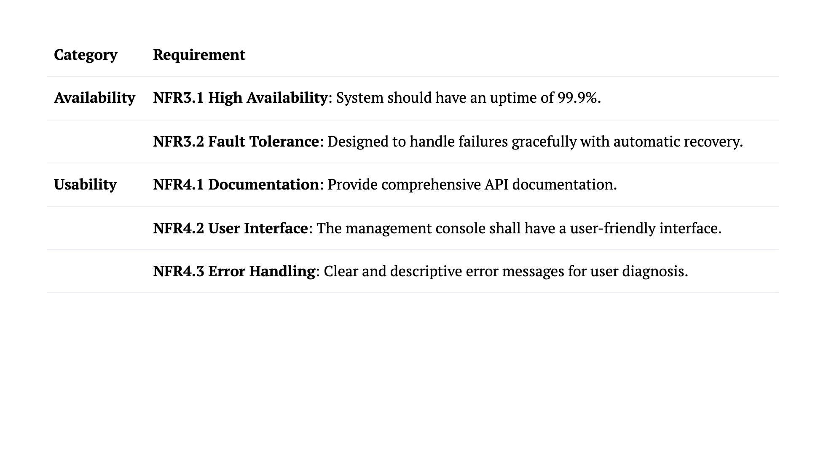
Notes:
For **availability**, our system is designed to ensure **high uptime**—at least **99.9%**—so that users can depend on its reliability. We also ensure **fault tolerance**, meaning that if there is a failure, the system should be able to **recover automatically** with minimal impact on end users. In terms of **usability**, we focus on providing **comprehensive API documentation**, which is critical for developers who need to interact with our system. A **user-friendly interface** for the management console will make system management easier for non-technical users. Finally, we have clear **error handling**, providing descriptive error messages to help users diagnose and resolve issues efficiently.

Slide 20
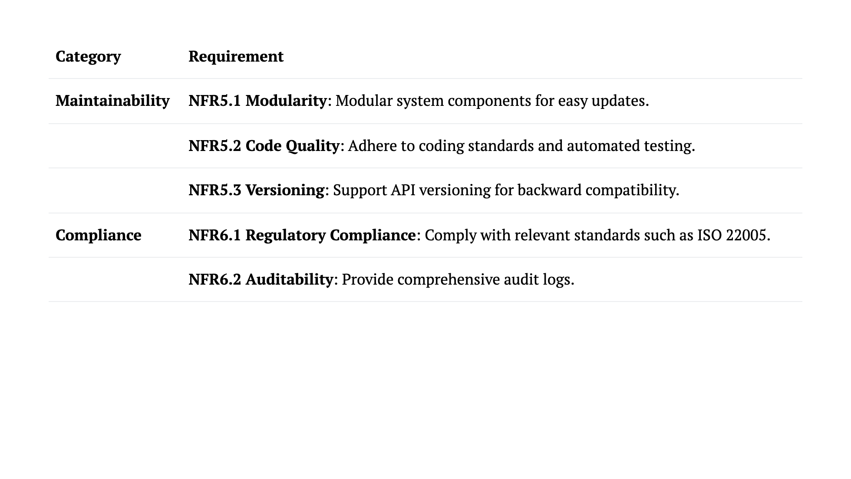
Notes:
**Maintainability** is key to making sure our system remains relevant and easily adaptable. To do this, we focus on **modularity**, which allows components to be updated or replaced independently without affecting the whole system. We ensure **code quality** by adhering to coding standards and using **automated testing**. Also, **API versioning** helps in maintaining backward compatibility, allowing older versions of APIs to remain functional. For **compliance**, we are committed to meeting relevant regulatory standards, including **ISO 22005** for food traceability. Additionally, we provide **auditability** by maintaining comprehensive audit logs, which help in tracking all activities within the system and proving compliance during assessments.

Slide 21
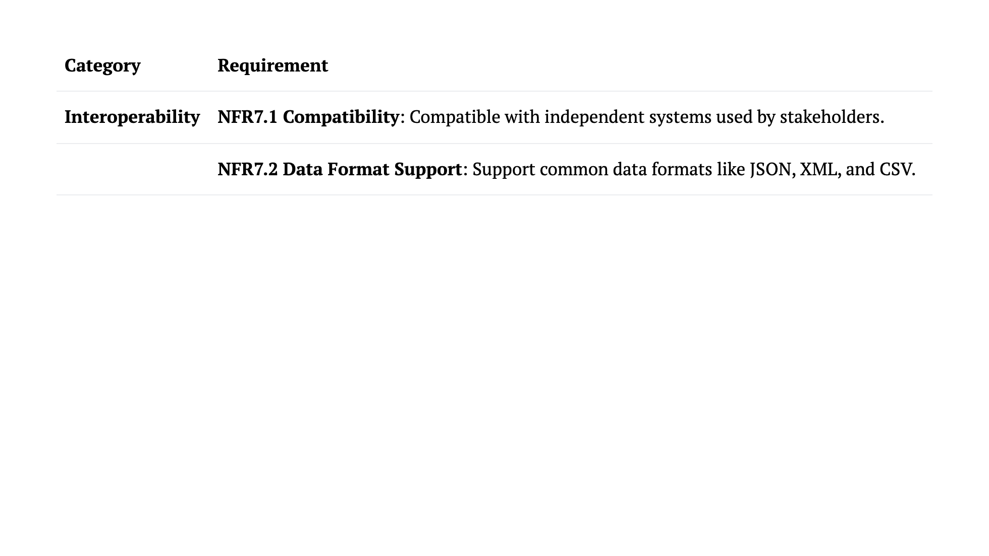
Notes:
Finally, let's address **interoperability**. Since the agricultural supply chain consists of various independent systems used by different stakeholders, our system must be **compatible** with these. This allows for seamless integration and data exchange without requiring significant changes to existing infrastructure. To support this, we ensure that the system can handle **multiple data formats** such as **JSON, XML, and CSV**. This flexibility makes it easier for data to be shared across diverse platforms, promoting smooth communication and integration among all stakeholders involved.

